Slide 1

Introduction to

Slide 2
What Will Be Covered
What is R & its Application
Introduction to Basic Coding in R
Hands-On Training (Day 2 and 3)

Slide 3
So, What is ?
Programming Language made by statistician for statistical computing and graphics

Slide 4

vs
Engine
Steering Wheel

Slide 5
Application of R
Statistical
Modelling /
Analysis
Data
Cleaning &
Wrangling
Data
Visualization
Reporting

Slide 6
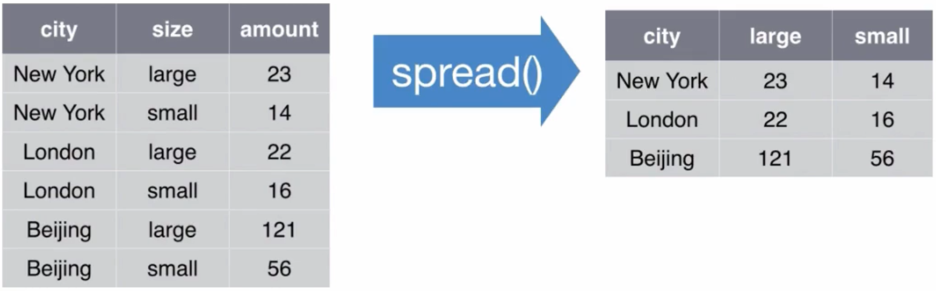
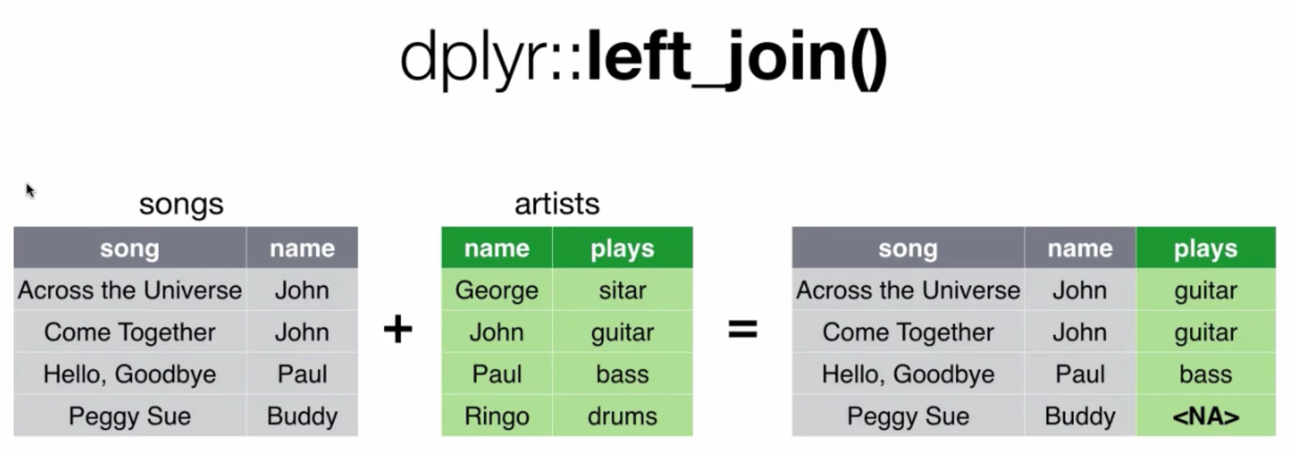
Data Cleaning & Wrangling
Screenshot taken from : RStudio Data Wrangling Webinar

Slide 7
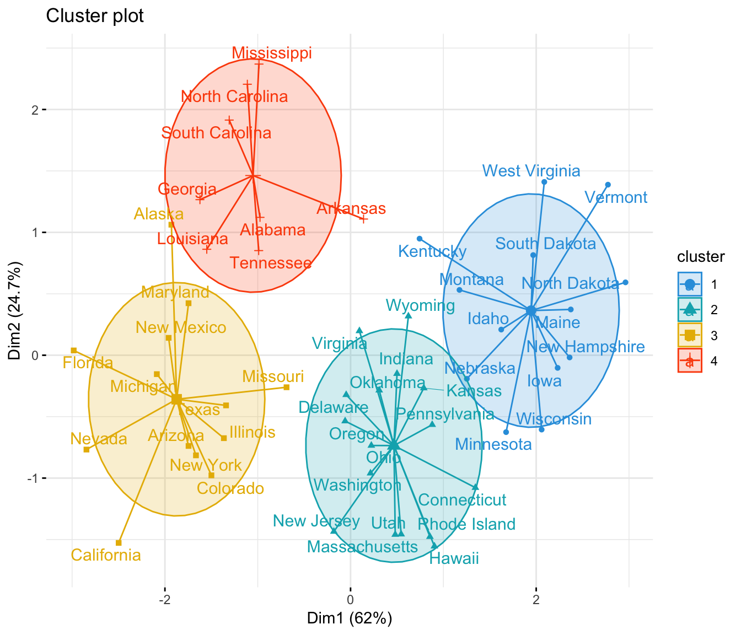
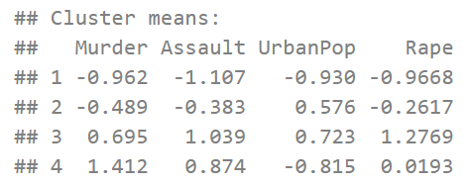
Statistical Modelling / Analysis
Source : datanovia.com

Slide 8
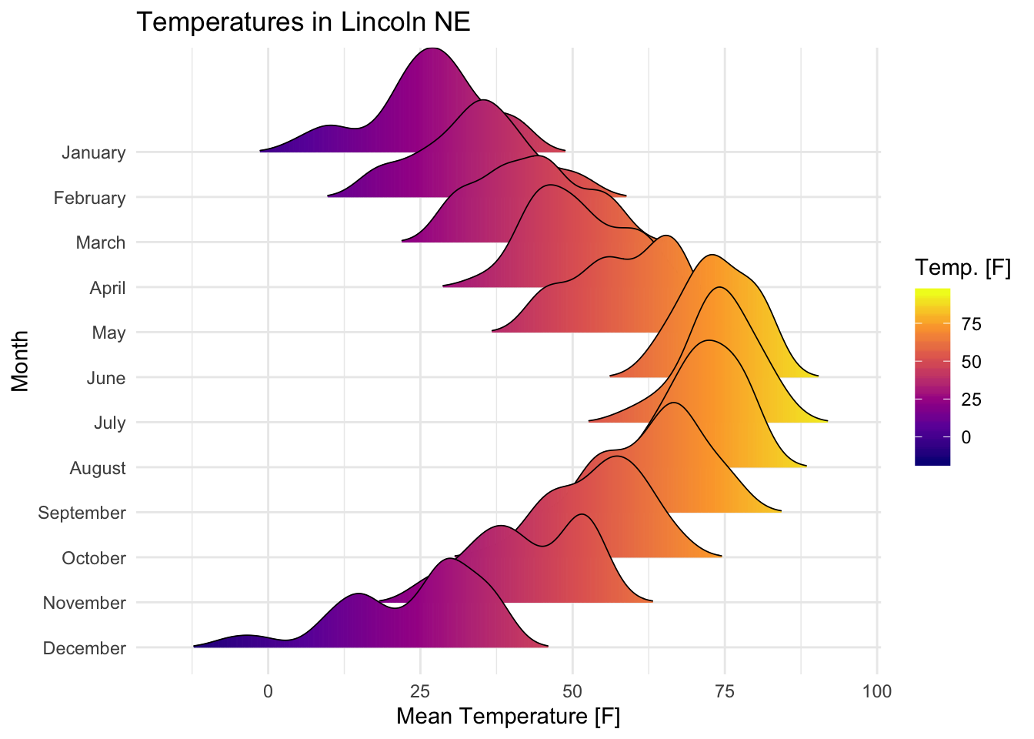
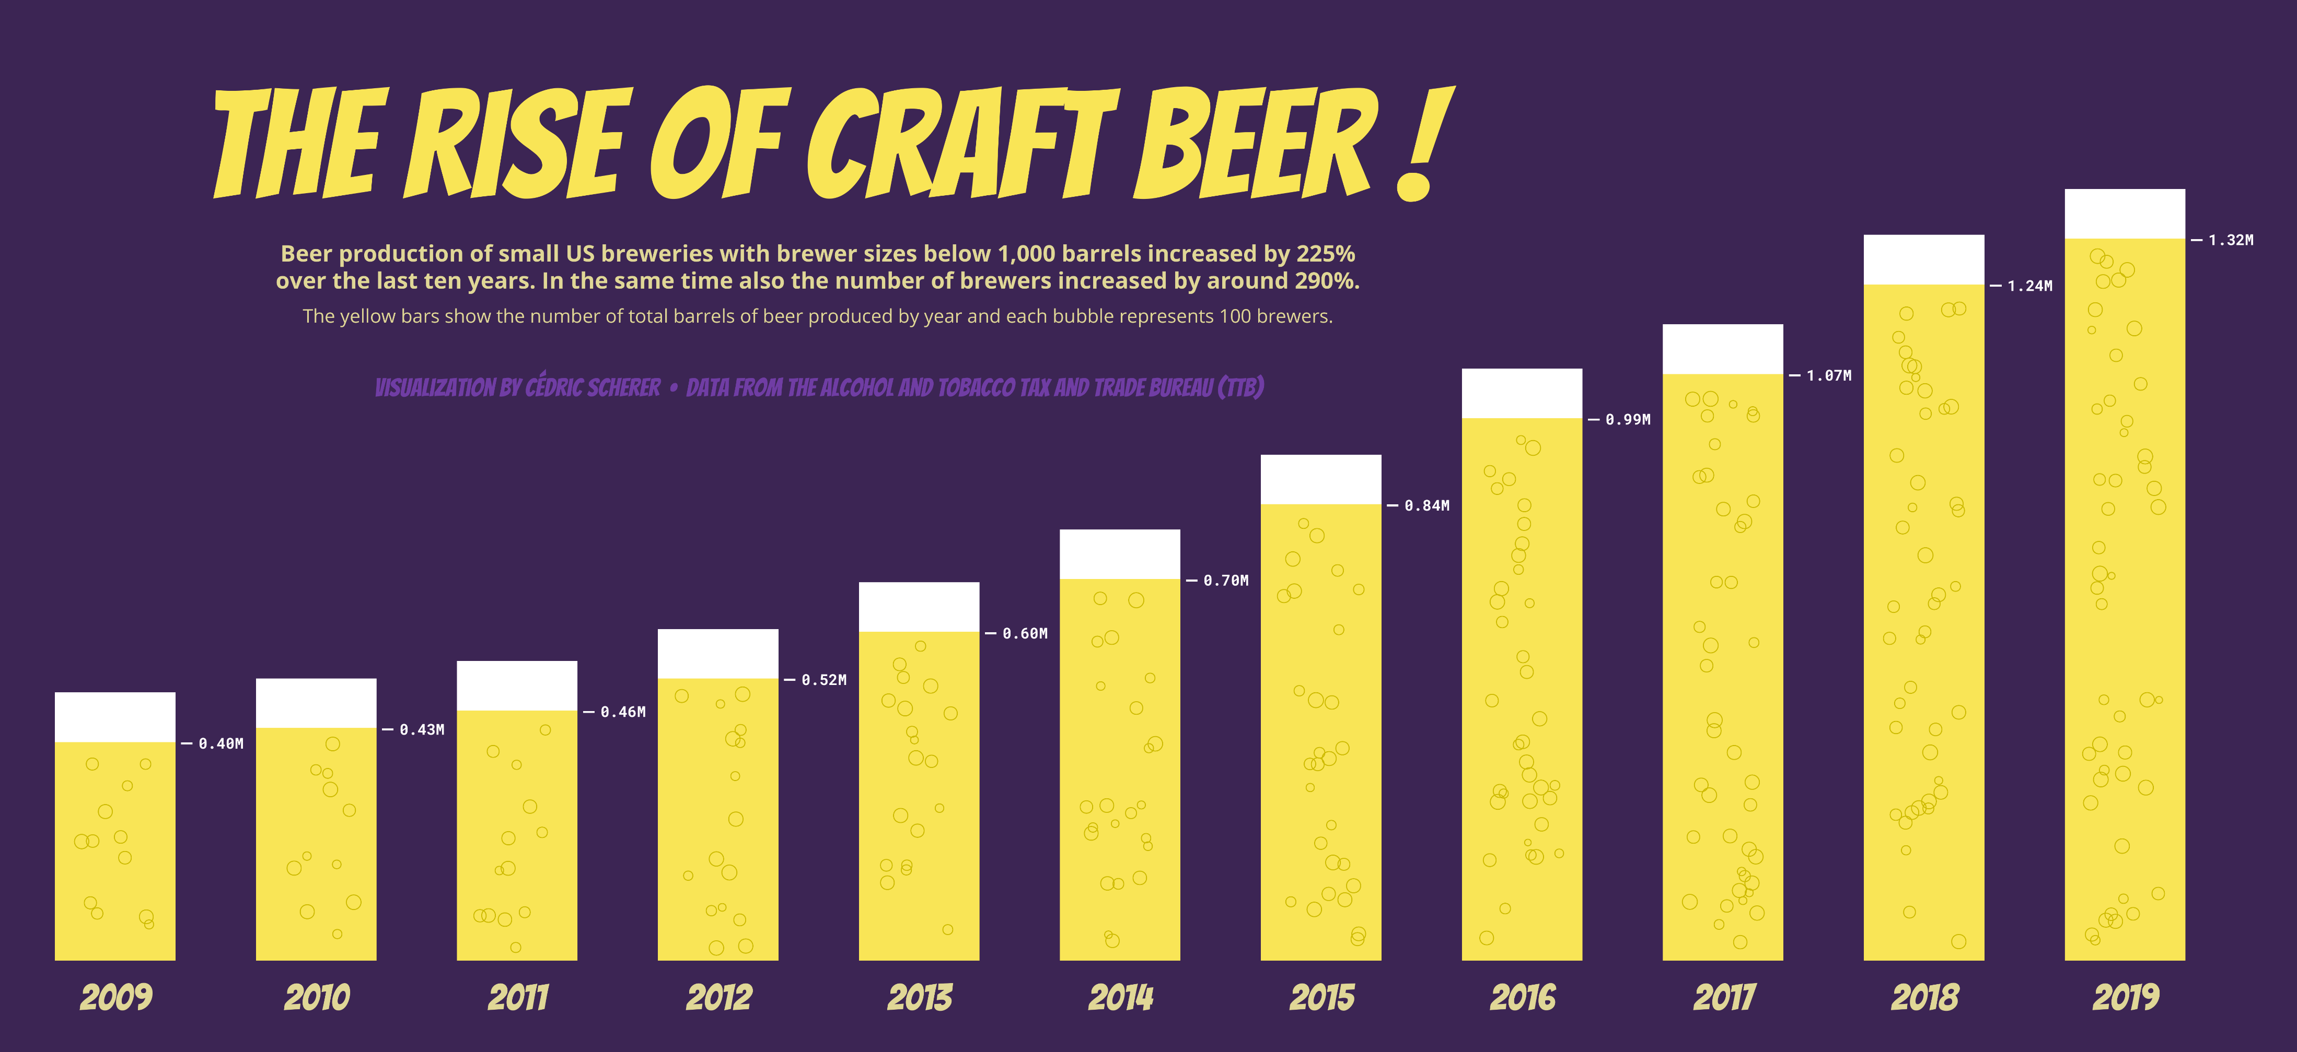
Data Visualization
Source : datanovia.com and Cedric Scherer

Slide 9

Why ? not ?
Better on Repetitive Task, Open-Source, “Unlimited”, More Option for Visualization

Slide 10
Introduction to Basic Coding in R
RStudio
Type of Data
Data Structure
Function
?help, stackoverflow
Packages
Pipeline ‘%>%’
Conditional Loop

Slide 11
Introduction
Cheatsheet RStudio IDE
Cheatsheet Basic R

Slide 12
Type of Data / Variabel
Character : ‘Greeneration’, ‘Ecor4ng3r’, ‘Jl. Citamiang No.6’
Numeric : 123, 5.6, 0.523
Factor : ‘1 = Pria’, ‘2 = Wanita’
Logical : TRUE dan FALSE
Date : ’01/01/2021’, ‘42705’
NA / NULL

Slide 13
Operator
<- or = for assigning value
+ , - , / , %% , ^ , ** math operator
< , > , == , != for comparator

Slide 14
Structure of Data
Single Value = Save only one value
Vector = Save more than one Single Value
Data Frame / Tibble = Save one or more Vector
List = Complex Data that able to save multiple data frame

Slide 15
Function
function(arg1 = …, arg2 = TRUE)
Name
Argument
To Input
Default
Value

Slide 16
How to memorize all those function?
Practically Impossible
?function / Google it!

Slide 17
Packages
Collection of Function and/or Datasets made by developers

Slide 18




Most Used Packages

Slide 19
How to deploy packages?
install.packages(“packages”)
library(packages)

Slide 20

PIPE
Operator to “Connect” function in R.
Making R code more readable.

Slide 21
Human Language
This_Data must be first_function then second_function and finally third_function
third_function(second_function(first_function(This Data))
Without
Pipe
With
Pipe
This_Data %>% first_function() %>% second_function() %>% third_function()

Slide 22
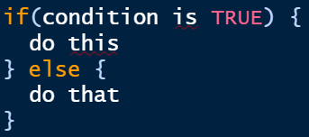


Conditional and Loop
If Else
For Loop
While Loop

